Slide 1
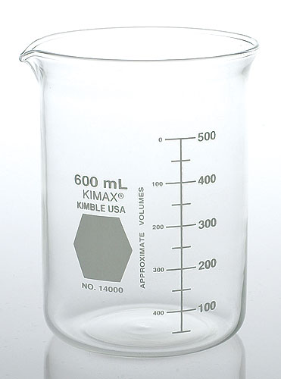

Slide 2
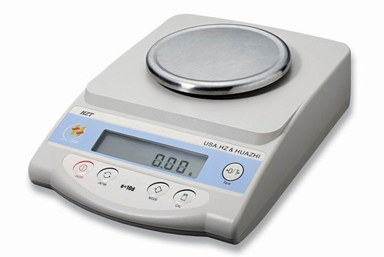

Slide 4
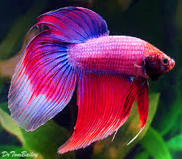

Slide 7
Figure 1. Average percent change in heart rate.

Slide 8
Figure 1. Average percent change in heart rate of Daphnia magna exposed to 0.1% caffeine, 1% nicotine, and 4% alcohol. Error bars are +/- 1 S.D.

Slide 9
Figure 1. Average percent change in heart rate of Daphnia magna exposed to 0.1% caffeine, 1% nicotine, and 4% alcohol. Error bars are +/- 1 S.D.
As you can see in Figure 1, …
Figure 1 shows …
The results for the average percent change in heart rate of Daphnia magna were summarized in Figure 1.
Present tense!

Slide 10
Figure 1. Average percent change in heart rate of Daphnia magna exposed to 0.1% caffeine, 1% nicotine, and 4% alcohol. Error bars are +/- 1 S.D.
The average percent change in heart rate for nicotine was much higher than that for caffeine (Fig. 1).
The application of 1% nicotine led to a large decrease in heart rate (Fig. 1).

Slide 11
Figure 1. Average percent change in heart rate of Daphnia magna exposed to 0.1% caffeine, 1% nicotine, and 4% alcohol. Error bars are +/- 1 S.D.
The average percent changes in heart rate of the Daphnia magna exposed to nicotine was much greater than the changes in heart rate experienced by the Daphnia exposed to caffeine and alcohol.

Slide 12
Figure 1. Average percent change in heart rate of Daphnia magna exposed to 0.1% caffeine, 1% nicotine, and 4% alcohol. Error bars are +/- 1 S.D.
The average percent change in heart rate of the Daphnia magna exposed to 1% nicotine was -35%, which was greater than the changes in heart rate recorded for the Daphnia exposed to 0.1% caffeine (-0.5%) and 4% alcohol (-21%) (Fig. 1).

Slide 13
Figure 1. Average percent change in heart rate of Daphnia magna exposed to 0.1% caffeine, 1% nicotine, and 4% alcohol. Error bars are +/- 1 S.D.
The standard deviations for the caffeine, nicotine, and alcohol data sets were 4.0%, 9.3%, and 8.2% respectively.
The error bars of the caffeine and nicotine data sets did not overlap, but those of the nicotine and alcohol data sets did.
The error bars of the nicotine and alcohol data sets overlap. Thus, these data are insignificant.

