Slide 1
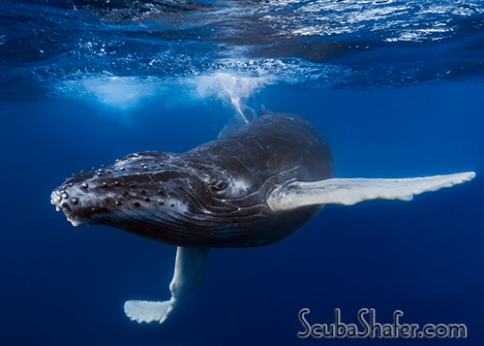
Class Mammalia, Order Cetartiodactyla, Suborder Mysticeti – baleen whales
Humpback whale (Megaptera novaeangliae)

Slide 2
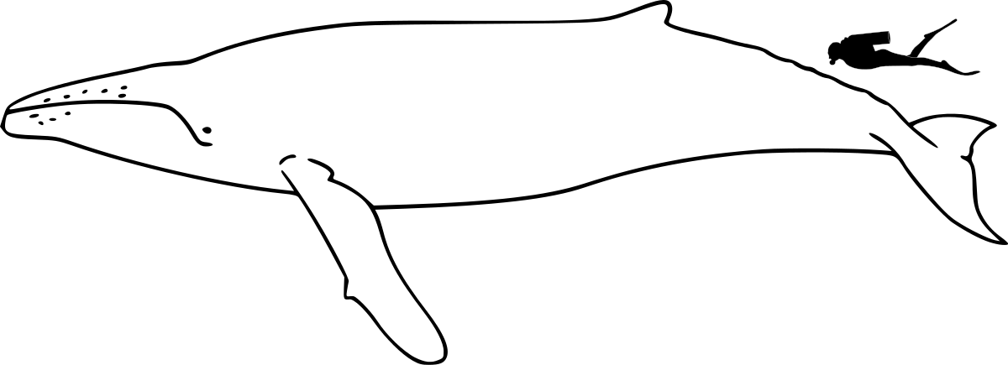
Adults
39 to 52 feet
79,000 lbs
Females > Males
By Chris huh, CC BY-SA 3.0, https://commons.wikimedia.org/w/index.php?curid=1862622

Slide 3
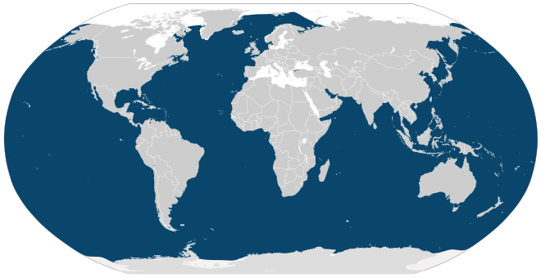

Slide 4
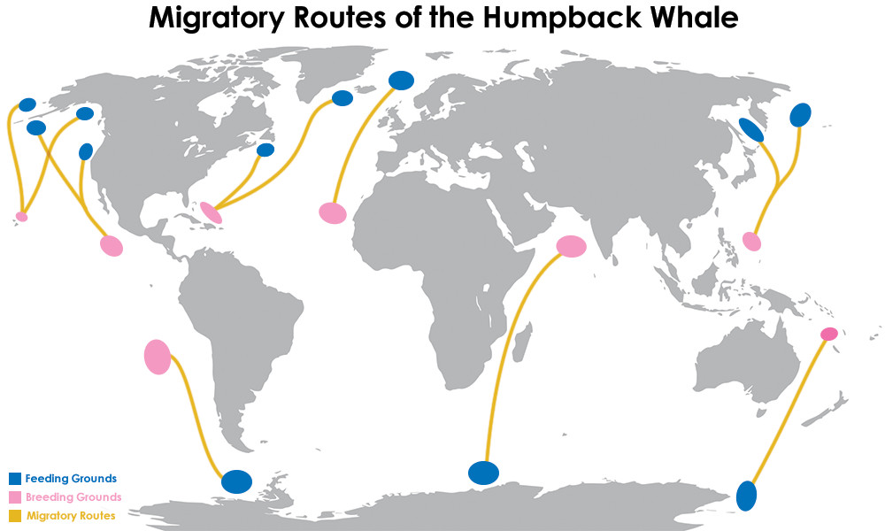
6-8 weeks
6,000 miles

Slide 5
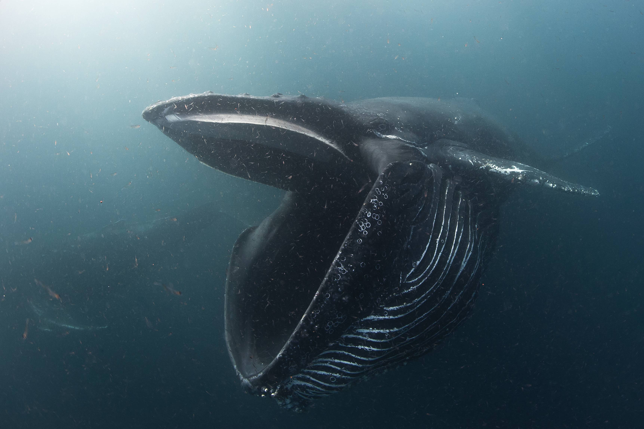
https://www.youtube.com/watch?v=Q8iDcLTD9wQ
Ventral Groove Blubber (VGB) Expands:
162% circumferentially
38% longitudinally

Slide 6
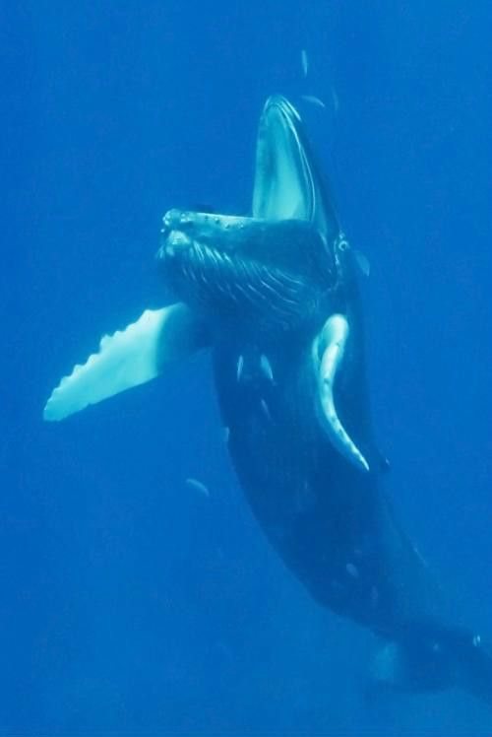
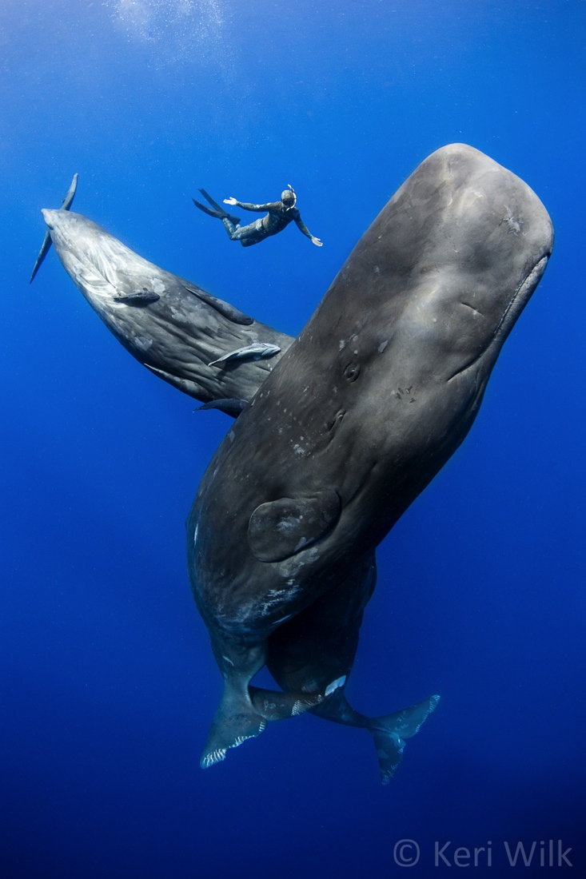
Two types of whales
Baleen
Toothed

Slide 7
Two types of whales
Baleen
Possess baleen

Slide 8
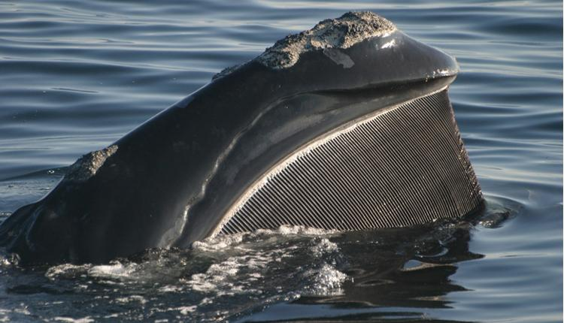

Slide 9
Two types of whales
Baleen
Possess baleen
Range in size
110 ft long – Blue (Sears, 2002)
21 ft long – Pygmy right (Kemper, 2002)

Slide 10
